Slide 1
Display Builder Web Runtime
Kay Kasemir
Feb. 2022

Slide 2
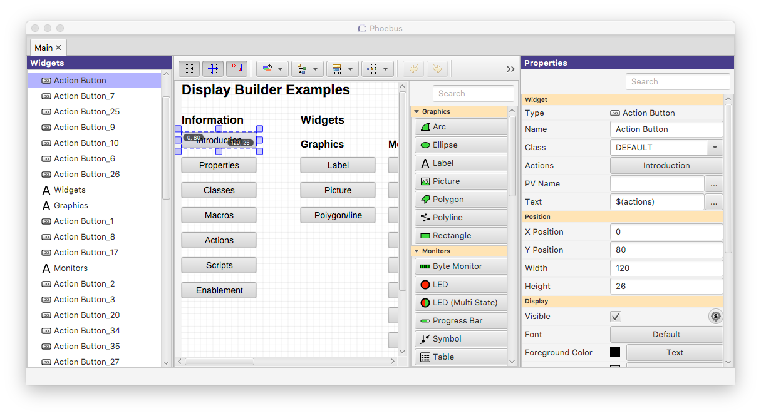
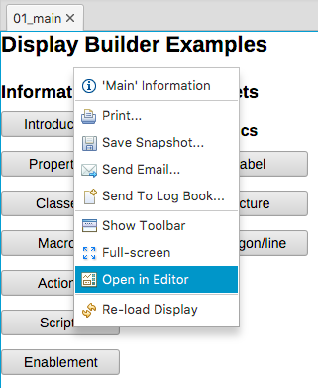
Display Builder in CS-Studio Desktop Tool
Best support for all widget types and their features
Includes editor for creating / modifying displays
But: Users need to install the tool, somehow access the display files, and the PV data (Channel Access, PV Access)

Slide 3
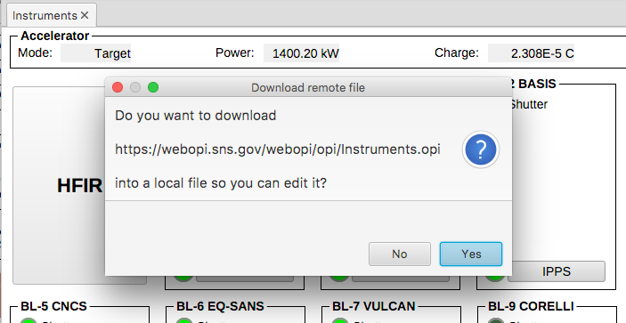
Storing Display Files on Web Server
Useful to make files available outside of control room
Safe, read-only, always up to date
.. But still using desktop tool.
To edit, you’ll be prompted for download

Slide 4
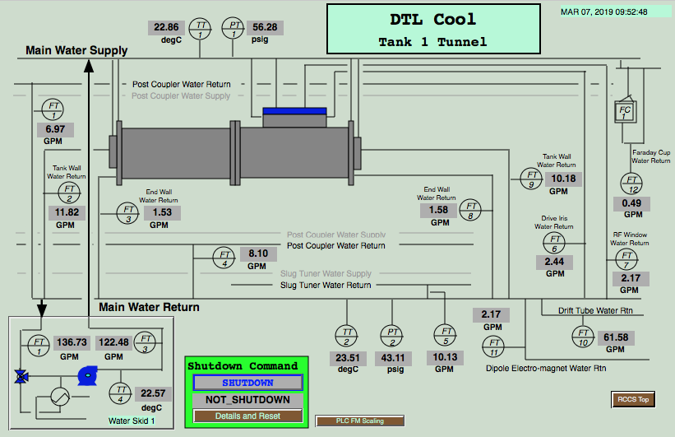
Display Builder Web Runtime
Client only has a web browser!
Some EPICS Display
Web Server (Tomcat)
Magic
Html, css, JavaScript
Metadata, then value updates
PV Web Socket
Ctrl System
At runtime, network traffic similar to { pv: "SomePV", value: 3.14
}

Slide 5
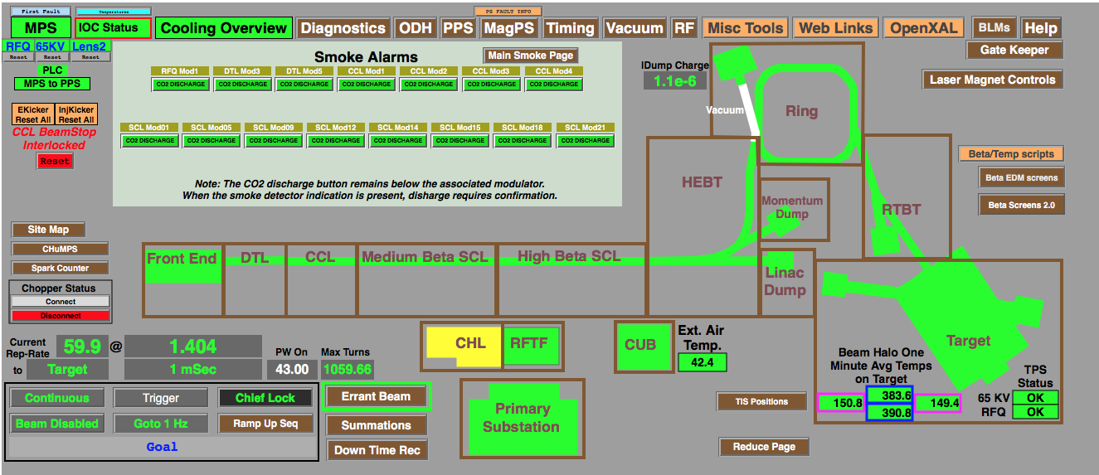
Web EDM
Ryan Slominski, JLab,
2017 EPICS Meeting
Very useful and performant for EDM displays and Channel Access IOCs Limitations:
No waveforms (plots, images)

Slide 6
Training Setup
Start web server: cd /ics/tools/apache-tomcat*/bin ./startup.sh
In web browser, open
http://localhost:8080/pvws
http://localhost:8080/dbwr
Stop: ./shutdown.sh

Slide 7
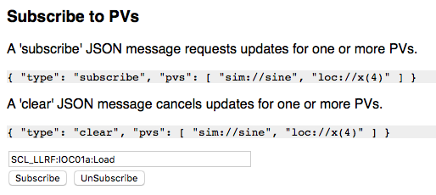
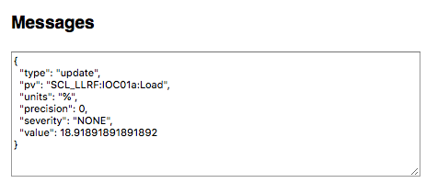
PV Web Socket - http://localhost:8080/pvws
Based on Phoebus Stack
VType PV for loc://, sim://, ca://, pva://, …
PV Pooling
RXJava Throttling
Data Packaged as JSON
Sends metadata once
No separate connections to *.EGU, *.PREC, …
Severity and value on change
Arrays packed as Base64-binary
JavaScript in client merges updates

Slide 8
Display Builder Web Runtime - http://localhost:8080/dbwr
Labels, LEDs, Text Updates
Groups, Embedded displays, Macros

Slide 9
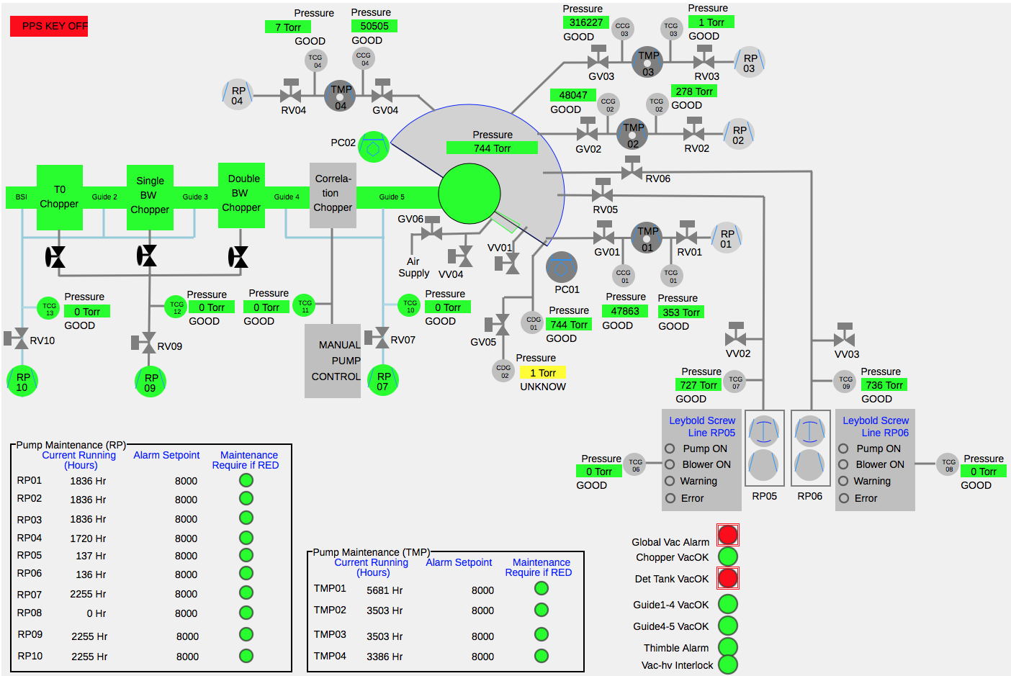
'Static’ Widgets
Lines,
Circles,
Rectangles, ..
Limited ‘Rule’
Support:
Some colors,
Hide/Show

Slide 10
Line and Detector plots

Slide 11
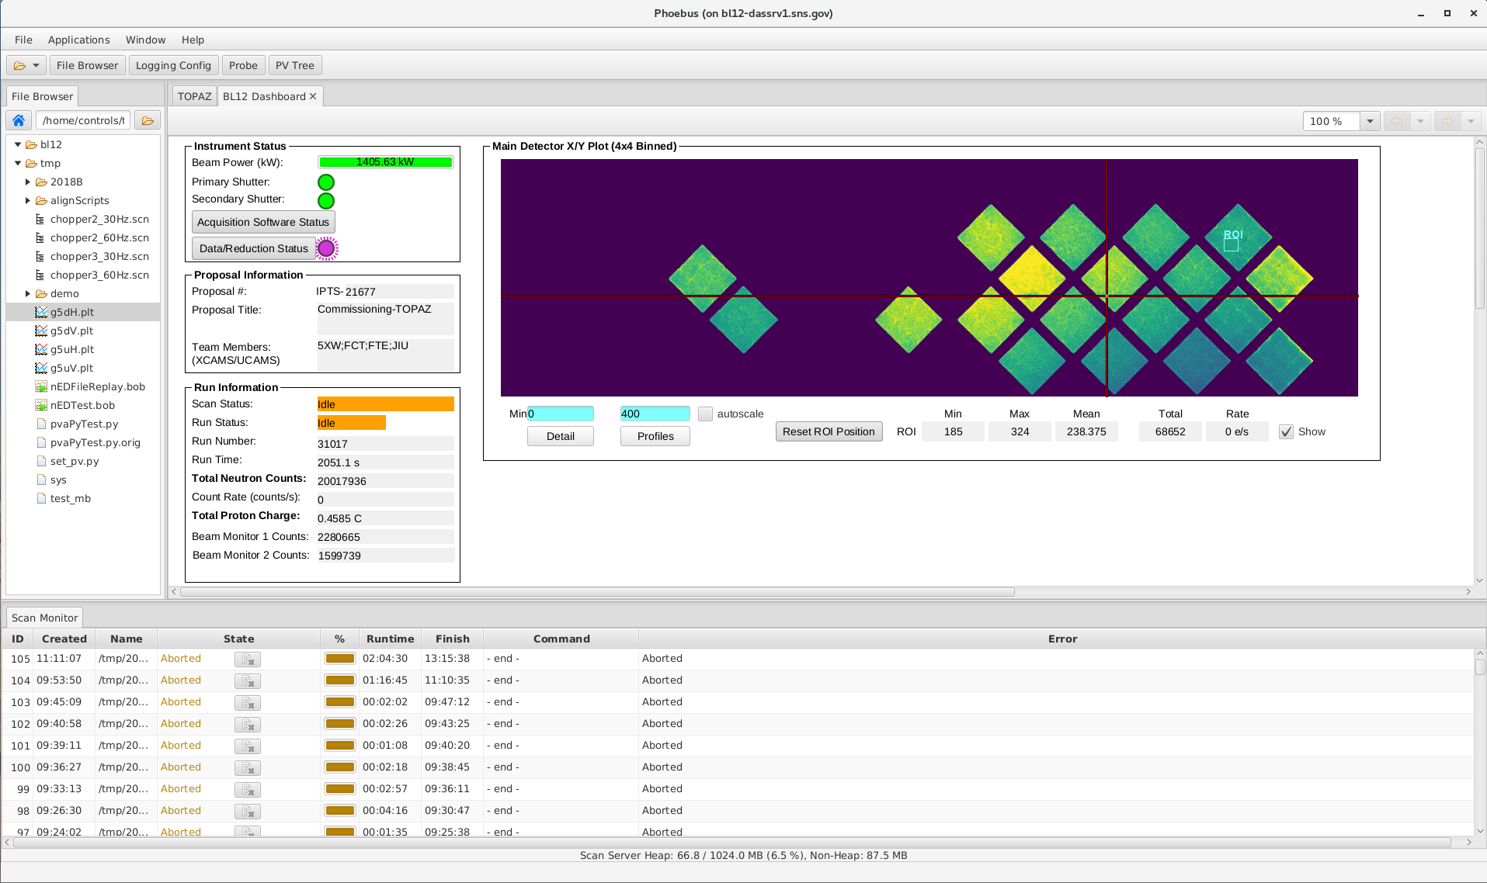
CS-Studio on Desktop vs. Web Runtime
Integrated Product
Easy Development
Type checking
Single-Language
Just Display Runtime
Scattered Development
No type checking
Client: HTML, CSS, JS Server: Java, Python, …
Different Web Browsers
Still: Read-only web view of control system is extremely convenient and useful!

Slide 12
Status: New Project, but already very useful
Label
Rectangle
Ellipse
Arc
Polyline
Polygon
Text Update
Text Input
Text formatting (precision, units, enum labels)
LED
Multi-State LED
Action Button to open display or web link
Combo
Group with group border
Embedded Displays
Tabs
XYPlot
Image
Macro support
Alarm-sensitive border based on PV
Limited Rule support: Color of rect/circle/label, visibility
Caching

Slide 13
Summary
Display Builder Web Runtime offers web access to much of the Desktop version
https://github.com/kasemir/pvws https://github.com/kasemir/dbwr
git clone
ant
copy *.war to Tomcat
Set environment: EPICS_CA_ADDR_LIST, ..
➔ http://your_tomcat/dbwr

